Slide 1
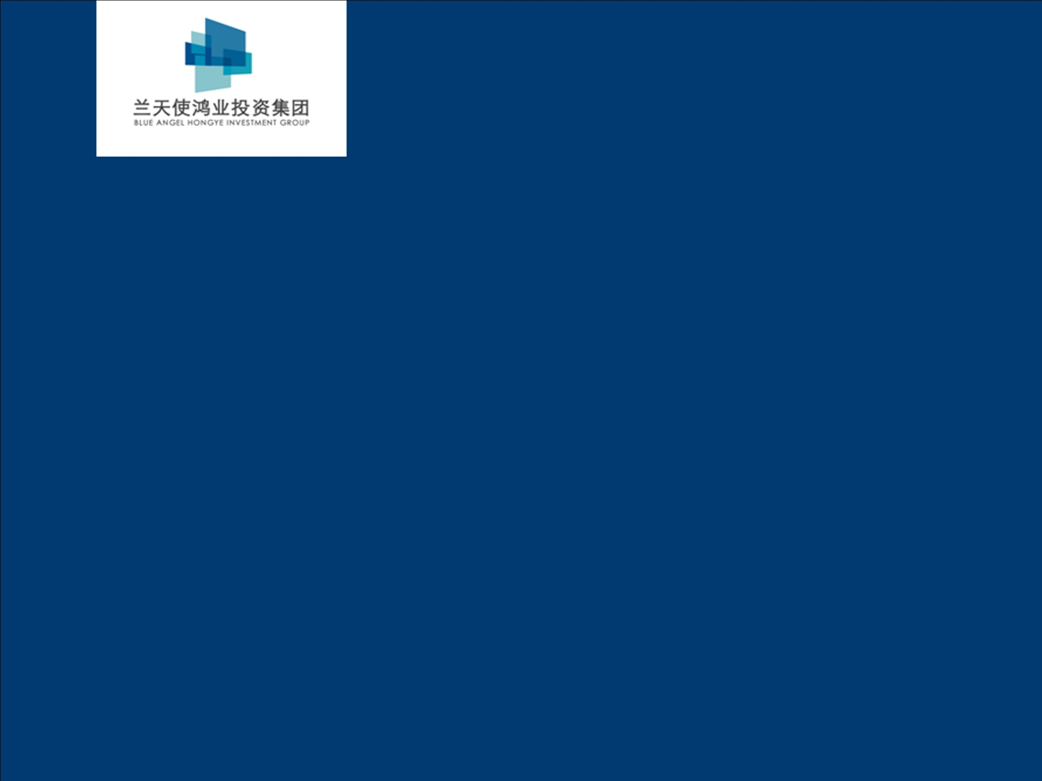
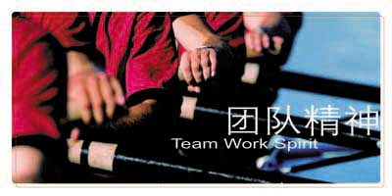

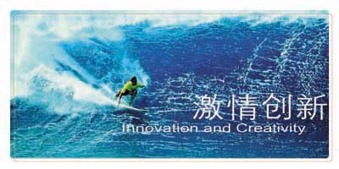
兰天使鸿业投资集团
Blue Angel Hongye Investment Group

Slide 2
集团介绍 Group Profile
The BAHY company was founded in 1996 and now has over 20 years rapid growth; The company has transferred its main office from Shenzhen to Beijing and Now extend its business to overseas; At present the business of our company consists of 4 parts: “Real Estate; Modern Agriculture; Architectural Design; International cooperation; To correspond "One Belt And One Road" in China's national development strategy, sharing the rapid growth of China's economy with partners.
Initiative Period
Stable Development period
Upgrade Period.
Global Expand Period
1996年—1999年
Shenzhen
2000年—2007年
Beijing
2008年—2013年
Beijing Economic Circle
2014年—
Oversea
Real estate planning
Advertising Creative
Video Production
Architectural Design
Decoration Engineering
Real Estate Development
Technology Transfer
Smart city
Modern Agriculture
Internet +
Financial Investment
International M&A
Oversea Development
Tourism development
Clean energy
+
+
+

Slide 3

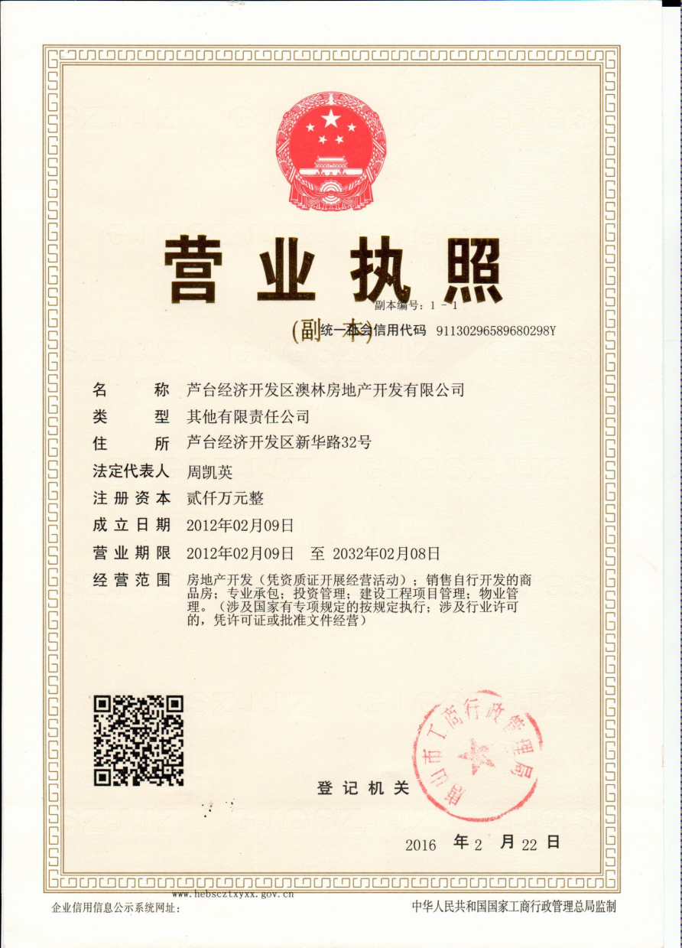
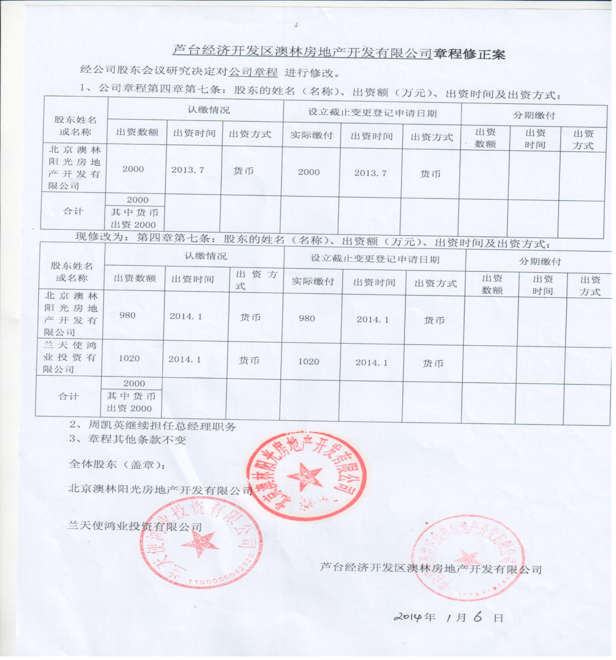
Subsidiary Company Introduction

Slide 4
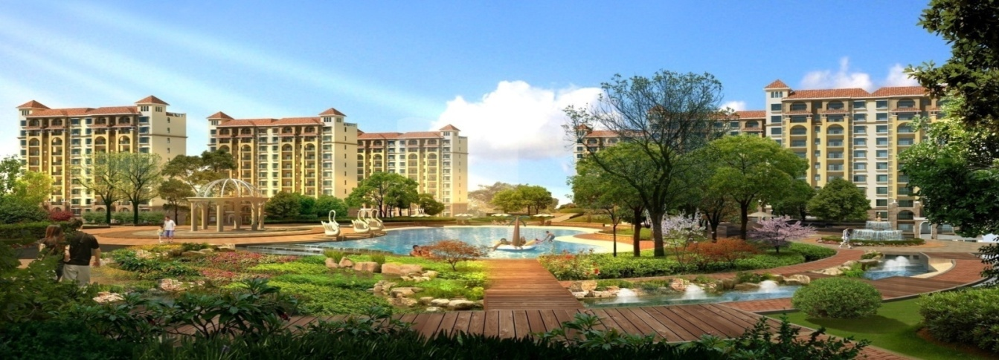
Project Introduction-----<The New Town of AoLin>
澳林新城房地产项目位于中国河北省唐山市芦台经济开发区，整体开发规模为100万平方米，项目设计采取西班牙建筑风格。
This project is located in the Lutai Economic Development Zone of Tangshan, Hebei province. The total development area is about 1 million sqm with the Spanish architectural style ;
首期“澳林公馆”公寓项目已开发建设，一期已经入住。
The first-phase project “ Aolin Residence ” is finished and have been accommodated;

Slide 5
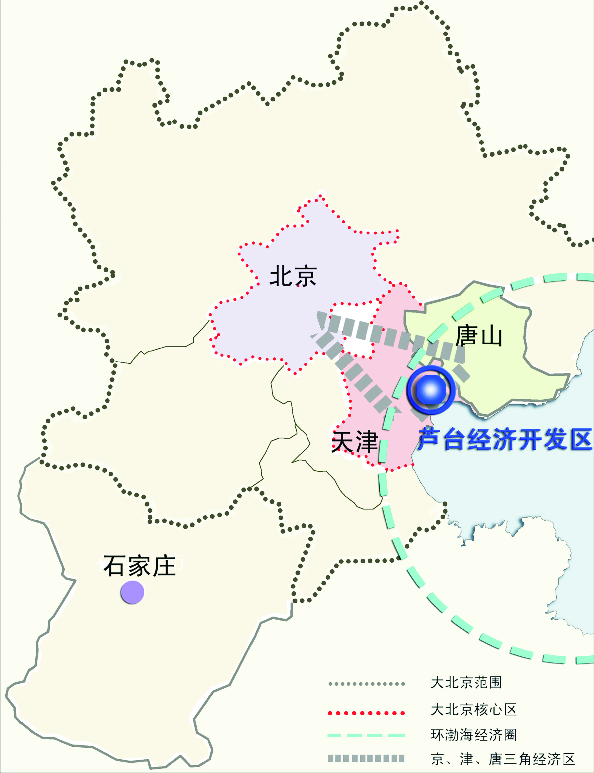
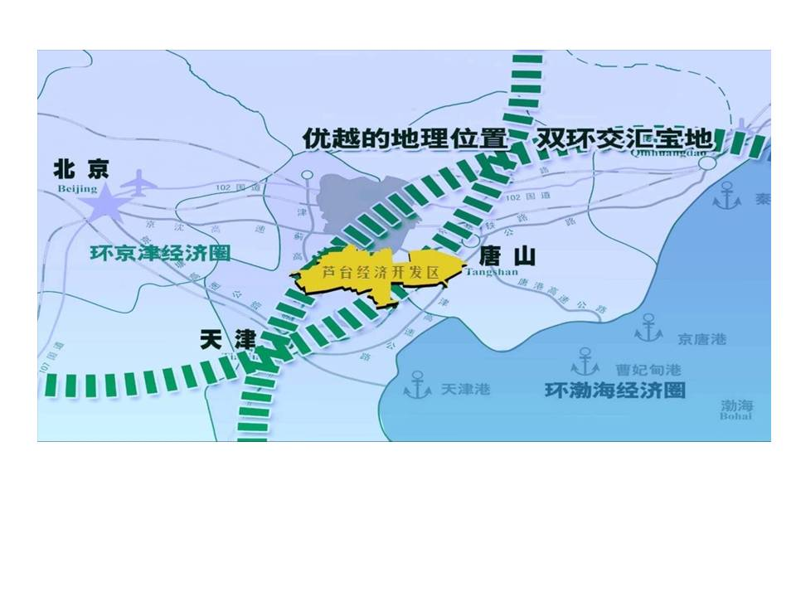
区域与背景 Area and Background
芦台经济技术开发区是天津“一轴两带三区”与唐山“四点一带”的交汇区，环渤海经济带、京津冀都市圈和冀东经济开发区的最前沿。在河北省打造的22个环京津卫星城市带中，是唐津两市合作的“桥头堡”，京津唐大都市的“后花园”。具有完善的海陆空一体交通网络。
Lutai Economic and Technological Development Area is located in the intersection joint area between Tianjin and Tangshan, the frontier around the economic belt in Boahai and the Economic and Technological Development area in east of Hebei, the back yard of the metropolitan cities, such as Beijing and Tianjin. It has the advantageous geographic position possessing in variety of transport of land, water and air freight.

Slide 6
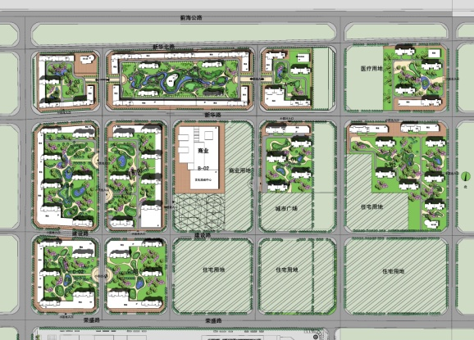
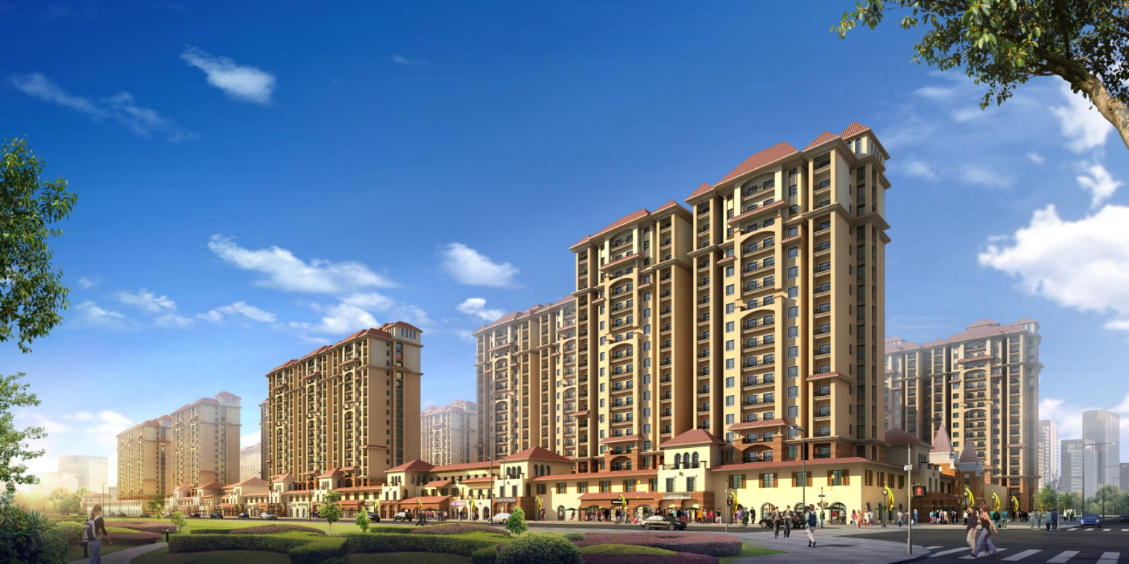
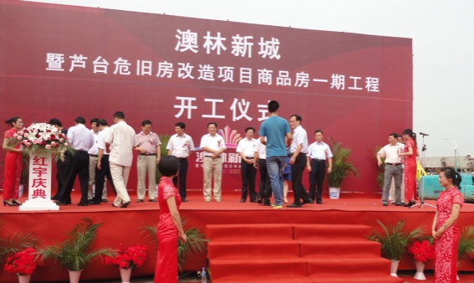
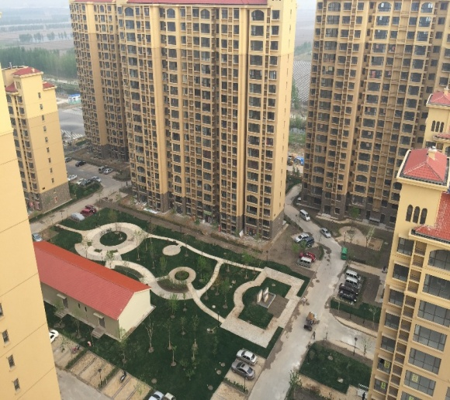
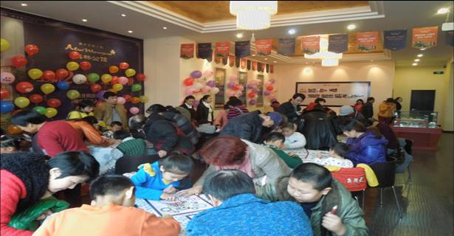
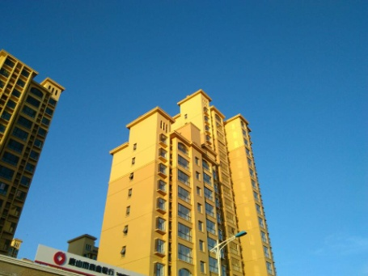
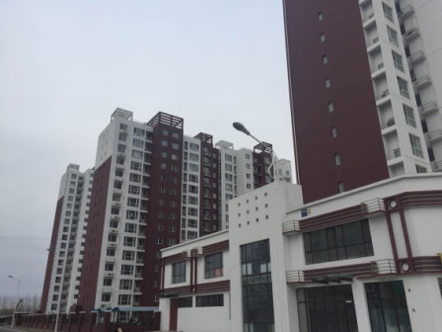
澳林新城地产品牌系列--京津冀区域内50万平方米棚改及百万平方米商品房开发项目

